Slide 1
CSE408 Complexity Classes
Lecture # 40

Slide 2
NP-Completeness
Poly time algorithm: input size n (in some encoding), worst case running time – O(n^{c}) for some constant c.
Three classes of problems
P: problems solvable in poly time.
NP: problems verifiable in poly time.
NPC: problems in NP and as hard as any problem in NP.

Slide 3
NP-Completeness (verifiable)
Verifiable in poly time: given a certificate of a solution, could verify the certificate is correct in poly time.
Examples (their definitions come later):
Hamiltonian-cycle, given a certificate of a sequence (v₁,v₂,…, v_{n}), easily verified in poly time.
3-CNF, given a certificate of an assignment 0s, 1s, easily verified in poly time.
(so try each instance, and verify it, but 2^{n} instances)
Why not defined as “solvable in exponential time?” or “Non Poly time”?

Slide 4
NP-Completeness (why NPC?)
A problem p ∈NP, and any other problem p′ ∈NP can be translated as p in poly time.
So if p can be solved in poly time, then all problems in NP can be solved in poly time.
All current known NP hard problems have been proved to be NPC.

Slide 5
Relation among P, NP, NPC
P ⊆ NP (Sure)
NPC ⊆ NP (sure)
P = NP (or P ⊂ NP, or P ≠ NP) ???
NPC = NP (or NPC ⊂ NP, or NPC ≠ NP) ???
P ≠ NP: one of the deepest, most perplexing open research problems in (theoretical) computer science since 1971.

Slide 6
Arguments about P, NP, NPC
No poly algorithm found for any NPC problem (even so many NPC problems)
No proof that a poly algorithm cannot exist for any of NPC problems, (even having tried so long so hard).
Most theoretical computer scientists believe that NPC is intractable (i.e., hard, and P ≠ NP).

Slide 7
View of Theoretical Computer Scientists on P, NP, NPC
NP
NPC
P
P ⊂ NP, NPC ⊂ NP, P ∩ NPC = ∅

Slide 8
Why discussion on NPC
If a problem is proved to be NPC, a good evidence for its intractability (hardness).
Not waste time on trying to find efficient algorithm for it
Instead, focus on design approximate algorithm or a solution for a special case of the problem
Some problems looks very easy on the surface, but in fact, is hard (NPC).

Slide 9
Decision VS. Optimization Problems
Decision problem: solving the problem by giving an answer “YES” or “NO”
Optimization problem: solving the problem by finding the optimal solution.
Examples:
SHORTEST-PATH (optimization)
Given G, u,v, find a path from u to v with fewest edges.
PATH (decision)
Given G, u,v, and k, whether exist a path from u to v consisting of at most k edges.

Slide 10
Decision VS. Optimization Problems (Cont.)
Decision is easier (i.e., no harder) than optimization
If there is an algorithm for an optimization problem, the algorithm can be used to solve the corresponding decision problem.
Example: SHORTEST-PATH for PATH
If optimization is easy, its corresponding decision is also easy. Or in another way, if provide evidence that decision problem is hard, then the corresponding optimization problem is also hard.
NPC is confined to decision problem. (also applicable to optimization problem.)
Another reason is that: easy to define reduction between decision problems.

Slide 11
(Poly) reduction between decision problems
Problem (class) and problem instance
Instance α of decision problem A and instance β of decision problem B
A reduction from A to B is a transformation with the following properties:
The transformation takes poly time
The answer is the same (the answer for α is YES if and only if the answer for β is YES).

Slide 12
Implication of (poly) reduction
YES
α
β
YES
(Poly) Reduction
Algorithm for B
Decision algorithm for A
NO
NO
If decision algorithm for B is poly, so does A.
A is no harder than B (or B is no easier than A)
2. If A is hard (e.g., NPC), so does B.
3. How to prove a problem B to be NPC ??
(at first, prove B is in NP, which is generally easy.)
3.1 find a already proved NPC problem A
3.2 establish an (poly) reduction from A to B
Question: What is and how to prove the first NPC problem?
Circuit-satisfiability problem.

Slide 13
Discussion on Poly time problems
Θ(n¹⁰⁰) vs. Θ(2^{n})
Reasonable to regard a problem of Θ(n¹⁰⁰) as intractable, however, very few practical problem with Θ(n¹⁰⁰).
Most poly time algorithms require much less.
Once a poly time algorithm is found, more efficient algorithm may follow soon.
Poly time keeps same in many different computation models, e.g., poly class of serial random-access machine ≡ poly class of abstract Turing machine ≡ poly class of parallel computer (#processors grows polynomially with input size)
Poly time problems have nice closure properties under addition, multiplication and composition.

Slide 14
Encoding impact on complexity
The problem instance must be represented in a way the program (or machine) can understand.
General encoding is “binary representation”.
Different encoding will result in different complexities.
Example: an algorithm, only input is integer k, running time is Θ(k).
If k is represented in unary: a string of k 1s, the running time is Θ(k) = Θ(n) on length-n input, poly on n.
If k is represented in binary: the input length n = ⎣ log k ⎦ +1, the running time is Θ(k) = Θ(2^{n}), exponential on n.
Ruling out unary, other encoding methods are same.

Slide 15
Examples of encoding and complexity
Given integer n, check whether n is a composite.
Dynamic programming for subset-sum.

Slide 16
Class P Problems
Let n= the length of binary encoding of a problem (i.e., input size), T(n) is the time to solve it.
A problem is poly-time solvable if T(n) =O(n^{k}) for some constant k.
Complexity class P=set of problems that are poly-time solvable.

Slide 17
Poly Time Verification
PATH problem: Given <G,u,v,k>, whether exists a path from u to v with at most k edges?
Moreover, also given a path p from u to v, verify whether the length of p is at most k?
Easy or not?
Of course, very easy.

Slide 18
Poly Time Verification, encoding, and language
Hamiltonian cycles
A simple path containing every vertex.
HAM-CYCLE={<G>: G is a Hamiltonian graph, i.e. containing Hamiltonian cycle}.
Suppose n is the length of encoding of G.
HAM-CYCLE can be considered as a Language after encoding, i.e. a subset of ∑* where ∑={0,1}*.
The naïve algorithm for determining HAM-CYCLE runs in Ω(m!)=Ω(2^{m}) time, where m is the number of vertices, m≈ n^{1/2}.
However, given an ordered sequence of m vertices (called “certificate”), let you verify whether the sequence is a Hamiltonian cycle. Very easy. In O(n²) time.

Slide 19
Class NP problems
For a problem p, given its certificate, the certificate can be verified in poly time.
Call this kind of problem an NP one.
Complement set/class: Co-NP.
Given a set S (as a universal) and given a subset A
The complement is that S-A.
When NP problems are represented as languages (i.e. a set), we can discuss their complement set, i.e., Co-NP.

Slide 20
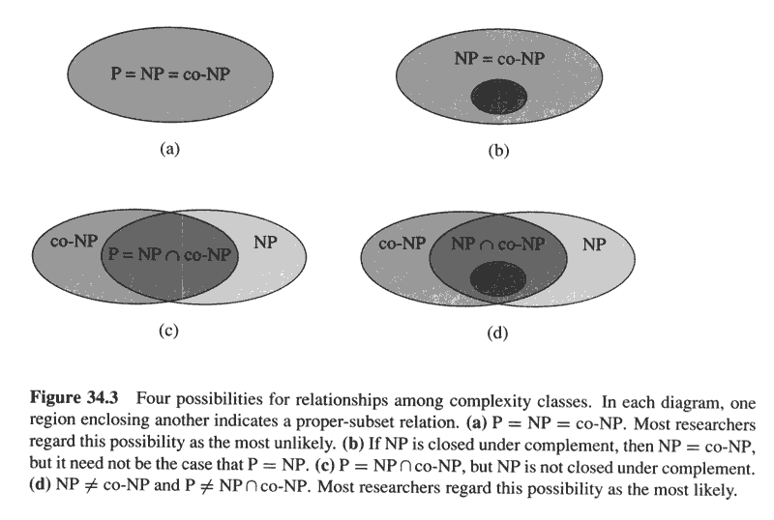
Relation among P, NP and co-NP={L: L ∈NP where L= ∑*-L}
P
P

Slide 21
NP-completeness and Reducibility
A (class of) problem P₁ is poly-time reducible to P₂ , written as P₁≤_{p} P₂ if there exists a poly-time function f: P₁ → P₂ such that for any instance of p₁∈ P₁, p₁ has “YES” answer if and only if answer to f(p₁) (∈ P₂) is also “YES”.
Theorem 34.3: (page 985)
For two problems P₁, P₂, if P₁≤_{p} P₂ then P₂ ∈ P implies P₁ ∈ P.

Slide 22
NP-completeness and Reducibility (cont.)
A problem p is NP-complete if
p ∈ NP and
p'≤_{p} p for every p' ∈ NP.
(if p satisfies 2, then p is said NP-hard.)
Theorem 34.4 (page 986)
if any NP-compete problem is poly-time solvable, then P=NP. Or say: if any problem in NP is not poly-time solvable, then no NP-complete problem is poly-time solvable.

Slide 23
First NP-complete problem—Circuit Satisfiability (problem definition)
Boolean combinational circuit
Boolean combinational elements, wired together
Each element, inputs and outputs (binary)
Limit the number of outputs to 1.
Called logic gates: NOT gate, AND gate, OR gate.
true table: giving the outputs for each setting of inputs
true assignment: a set of boolean inputs.
satisfying assignment: a true assignment causing the output to be 1.
A circuit is satisfiable if it has a satisfying assignment.

Slide 24
Circuit Satisfiability Problem: definition
Circuit satisfying problem: given a boolean combinational circuit composed of AND, OR, and NOT, is it stisfiable?
CIRCUIT-SAT={<C>: C is a satisfiable boolean circuit}
Implication: in the area of computer-aided hardware optimization, if a subcircuit always produces 0, then the subcircuit can be replaced by a simpler subcircuit that omits all gates and just output a 0.

Slide 25
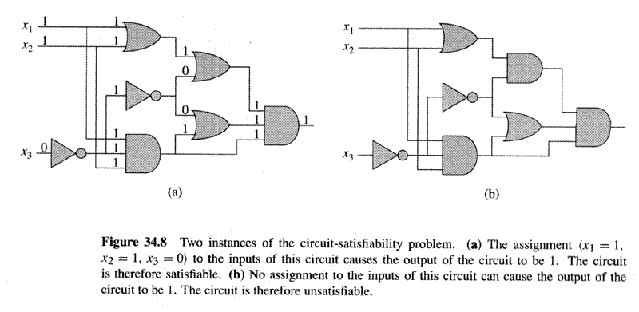
Two instances of circuit satisfiability problems

Slide 26
Solving circuit-satisfiability problem
Intuitive solution:
for each possible assignment, check whether it generates 1.
suppose the number of inputs is k, then the total possible assignments are 2^{k}. So the running time is Ω(2^{k}). When the size of the problem is Θ(k), then the running time is not poly.

Slide 27
Circuit-satisfiability problem is NP-complete
Lemma 34.5:(page 990)
CIRCUIT-SAT belongs to NP.
Proof: CIRCUIT-SAT is poly-time verifiable.
Given (an encoding of) a CIRCUIT-SAT problem C and a certificate, which is an assignment of boolean values to (all) wires in C.
The algorithm is constructed as follows: just checks each gates and then the output wire of C:
If for every gate, the computed output value matches the value of the output wire given in the certificate and the output of the whole circuit is 1, then the algorithm outputs 1, otherwise 0.
The algorithm is executed in poly time (even linear time).
An alternative certificate: a true assignment to the inputs.

Slide 28
Circuit-satisfiability problem is NP-complete (cont.)
Lemma 34.6: (page 991)
CIRCUIT-SAT is NP-hard.
Proof: Suppose X is any problem in NP
construct a poly-time algorithm F maps every problem instance x in X to a circuit C=f(x) such that the answer to x is YES if and only if C∈CIRCUIT-SAT (is satisfiable).

Slide 29
Circuit-satisfiability problem is NP-hard (cont.)
Since X∈NP, there is a poly-time algorithm A which verifies X.
Suppose the input length is n and Let T(n) denote the worst-case running time. Let k be the constant such that T(n)=O(n^{k}) and the length of the certificate is O(n^{k}).

Slide 30
Circuit-satisfiability problem is NP-hard (cont.)
Idea is to represent the computation of A as a sequence of configurations, c₀, c₁,…,c_{i},c_{i+1},…,c_{T(n)}, each c_{i} can be broken into
(program for A, program counter PC, auxiliary machine state, input x, certificate y, working storage) and
c_{i} is mapped to c_{i+1} by the combinational circuit M implementing the computer hardware.
The output of A: 0 or 1– is written to some designated location in working storage. If the algorithm runs for at most T(n) steps, the output appears as one bit in c_{T(n)}.
Note: A(x,y)=1 or 0.

Slide 31
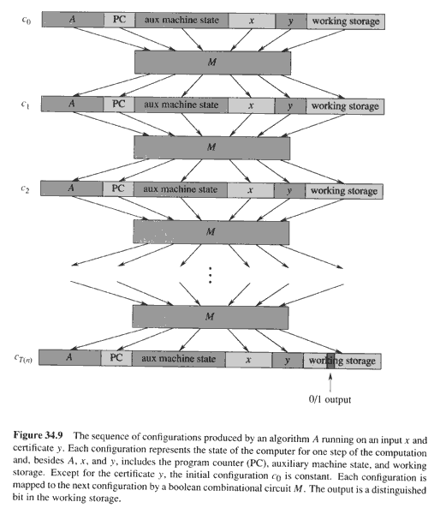
Copyright © The McGraw-Hill Companies, Inc. Permission required for reproduction or display.

Slide 32
Circuit-satisfiability problem is NP-hard (cont.)
The reduction algorithm F constructs a single combinational circuit C as follows:
Paste together all T(n) copies of the circuit M.
The output of the ith circuit, which produces c_{i}, is directly fed into the input of the (i+1)st circuit.
All items in the initial configuration, except the bits corresponding to certificate y, are wired directly to their known values.
The bits corresponding to y are the inputs to C.
All the outputs to the circuit are ignored, except the one bit of c_{T(n)} corresponding to the output of A.

Slide 33
Circuit-satisfiability problem is NP-hard (cont.)
Two properties remain to be proven:
F correctly constructs the reduction, i.e., C is satisfiable if and only if there exists a certificate y, such that A(x,y)=1.
⇐Suppose there is a certificate y, such that A(x,y)=1. Then if we apply the bits of y to the inputs of C, the output of C is the bit of A(x,y), that is C(y)= A(x,y) =1, so C is satisfiable.
⇒Suppose C is satisfiable, then there is a y such that C(y)=1. So, A(x,y)=1.
F runs in poly time.

Slide 34
Circuit-satisfiability problem is NP-hard (cont.)
F runs in poly time.
Poly space:
Size of x is n.
Size of A is constant, independent of x.
Size of y is O(n^{k}).
Amount of working storage is poly in n since A runs at most O(n^{k}).
M has size poly in length of configuration, which is poly in O(n^{k}), and hence is poly in n.
C consists of at most O(n^{k}) copies of M, and hence is poly in n.
Thus, the C has poly space.
The construction of C takes at most O(n^{k}) steps and each step takes poly time, so F takes poly time to construct C from x.

Slide 35
CIRCUIT-SAT is NP-complete
In summary
CIRCUIT-SAT belongs to NP, verifiable in poly time.
CIRCUIT-SAT is NP-hard, every NP problem can be reduced to CIRCUIT-SAT in poly time.
Thus CIRCUIT-SAT is NP-complete.

Slide 36
NP-completeness proof basis
Lemma 34.8 (page 995)
If X is a problem (class) such that P'≤_{p} X for some P' ∈ NPC, then X is NP-hard. Moreover, if X∈ NP, then X∈ NPC.
Steps to prove X is NP-complete
Prove X∈ NP.
Given a certificate, the certificate can be verified in poly time.
Prove X is NP-hard.
Select a known NP-complete P'.
Describe a transformation function f that maps every instance x of P' into an instance f(x) of X.
Prove f satisfies that the answer to x∈P' is YES if and only if the answer to f(x)∈X is YES for all instance x ∈P'.
Prove that the algorithm computing f runs in poly-time.

Slide 37
NPC proof –Formula Satisfiability (SAT)
SAT definition
n boolean variables: x₁, x₂,…, x_{n}.
M boolean connectives: any boolean function with one or two inputs and one output, such as ∧,∨,¬,→,↔,… and
Parentheses.
A SAT φ is satisfiable if there exists an true assignment which causes φ to evaluate to 1.
SAT={< φ>: φ is a satifiable boolean formula}.
The historical honor of the first NP-complete problem ever shown.

Slide 38
SAT is NP-complete
Theorem 34.9: (page 997)
SAT is NP-complete.
Proof:
SAT belongs to NP.
Given a satisfying assignment, the verifying algorithm replaces each variable with its value and evaluates the formula, in poly time.
SAT is NP-hard (show CIRCUIT-SAT≤_{p} SAT).

Slide 39
SAT is NP-complete (cont.)
CIRCUIT-SAT≤_{p} SAT, i.e., any instance of circuit satisfiability can be reduced in poly time to an instance of formula satisfiability.
Intuitive induction:
Look at the gate that produces the circuit output.
Inductively express each of gate’s inputs as formulas.
Formula for the circuit is then obtained by writing an expression that applies the gate’s function to its input formulas.
Unfortunately, this is not a poly reduction
Shared formula (the gate whose output is fed to 2 or more inputs of
other gates) cause the size of generated formula to grow exponentially.

Slide 40
SAT is NP-complete (cont.)
Correct reduction:
For every wire x_{i} of C, give a variable x_{i} in the formula.
Every gate can be expressed as x_{o}↔(x_{i1}θ x_{i2}θ… θ x_{il})
The final formula φ is the AND of the circuit output variable and conjunction of all clauses describing the operation of each gate. (example Figure 34.10)
Correctness of the reduction
Clearly the reduction can be done in poly time.
C is satisfiable if and only if φ is satisfiable.
If C is satisfiable, then there is a satisfying assignment. This means that each wire of C has a well-defined value and the output of C is 1. Thus the assignment of wire values to variables in φ makes each clause in φ evaluate to 1. So φ is 1.
The reverse proof can be done in the same way.

Slide 41
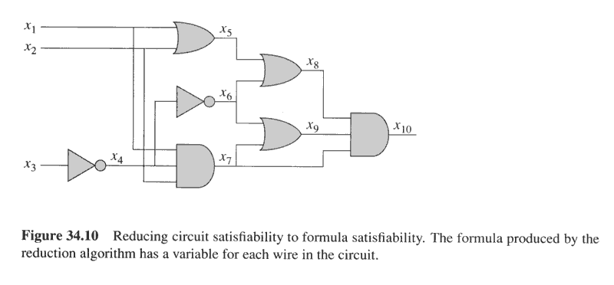
Example of reduction of CIRCUIT-SAT to SAT
φ= x₁₀∧(x₁₀↔(x₇∧ x₈∧ x₉))
∧(x₉↔(x₆ ∨ x₇))
∧(x₈↔(x₅ ∨ x₆))
∧(x₇↔(x₁∧ x₂∧ x₄))
∧(x₆↔ ¬x₄))
∧(x₅↔(x₁ ∨ x₂))
∧(x₄↔¬x₃)
INCORRECT REDUCTION: φ= x₁₀= x₇∧ x₈∧ x₉=(x₁∧ x₂∧ x₄) ∧ (x₅ ∨ x₆)∧ (x₆ ∨ x₇)
=(x₁∧ x₂∧ x₄) ∧ ((x₁ ∨ x₂) ∨ ¬x₄)∧ (¬x₄ ∨ (x₁∧ x₂∧ x₄))=….

Slide 42
NPC Proof –3-CNF Satisfiability
3-CNF definition
A literal in a boolean formula is an occurrence of a variable or its negation.
CNF (Conjunctive Nornal Form) is a boolean formula expressed as AND of clauses, each of which is the OR of one or more literals.
3-CNF is a CNF in which each clause has exactly 3 distinct literals (a literal and its negation are distinct)
3-CNF-SAT: whether a given 3-CNF is satiafiable?

Slide 43
3-CNF-SAT is NP-complete
Proof: 3-CNF-SAT ∈NP. Easy.
3-CNF-SAT is NP-hard. (show SAT ≤_{p}3-CNF-SAT)
Suppose φ is any boolean formula, Construct a binary ‘parse’ tree, with literals as leaves and connectives as internal nodes.
Introduce a variable y_{i} for the output of each internal nodes.
Rewrite the formula to φ' as the AND of the root variable and a conjunction of clauses describing the operation of each node.
The result is that in φ', each clause has at most three literals.
Change each clause into conjunctive normal form as follows:
Construct a true table, (small, at most 8 by 4)
Write the disjunctive normal form for all true-table items evaluating to 0
Using DeMorgan law to change to CNF.
The resulting φ'' is in CNF but each clause has 3 or less literals.
Change 1 or 2-literal clause into 3-literal clause as follows:
If a clause has one literal l, change it to (l∨p∨q)∧(l∨p∨¬q)∧ (l∨¬p∨q)∧ (l∨¬p∨¬q).
If a clause has two literals (l₁∨ l₂), change it to (l₁∨ l₂ ∨p) ∧ (l₁∨ l₂ ∨¬p).

Slide 44
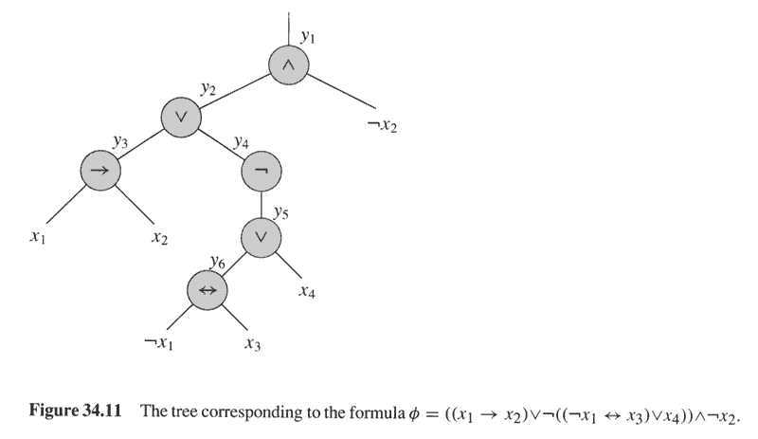
Binary parse tree for φ=((x₁→ x₂) ∨¬((¬x₁↔ x₃) ∨ x₄))∧¬x₂
φ'= y₁∧(y₁ ↔ (y₂∧¬x₂))
∧(y₂ ↔ (y₃ ∨ y₄))
∧(y₄ ↔ ¬y₅)
∧(y₃ ↔ (x₁ → x₂))
∧(y₅ ↔ (y₆ ∨ x₄))
∧(y₆ ↔ (¬x₁ ↔ x₃))

Slide 45
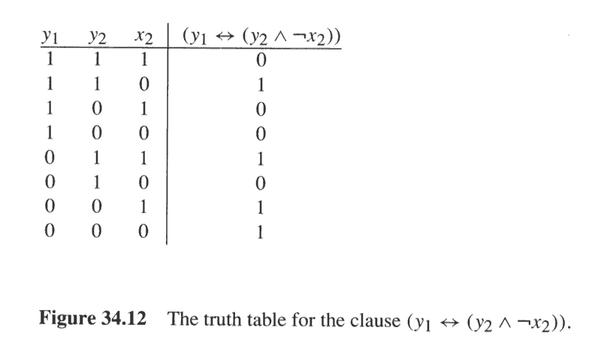
Example of Converting a 3-literal clause to CNF format
Disjunctive Normal Form:
φ_{i}'=(y₁∧y₂∧x₂)∨(y₁∧¬y₂∧x₂)
∨(y₁∧¬y₂∧¬x₂) ∨(¬y₁∧y₂∧¬x₂)
Conjunctive Normal Form:
φ_{i}''=(¬y₁∨¬y₂∨¬x₂)∧(¬y₁∨y₂∨¬x₂)
∧(¬y₁∨y₂∨x₂)∧(y₁∨¬y₂∨x₂)

Slide 46
3-CNF is NP-complete
φ and reduced 3-CNF are equivalent:
From φ to φ' , keep equivalence.
From φ' to φ'' , keep equivalence.
From φ'' to final 3-CNF, keep equivalence.
Reduction is in poly time,
From φ to φ' , introduce at most 1 variable and 1 clause per connective in φ.
From φ' to φ'' , introduce at most 8 clauses for each clause in φ'.
From φ'' to final 3-CNF, introduce at most 4 clauses for each clause in φ''.

Slide 47
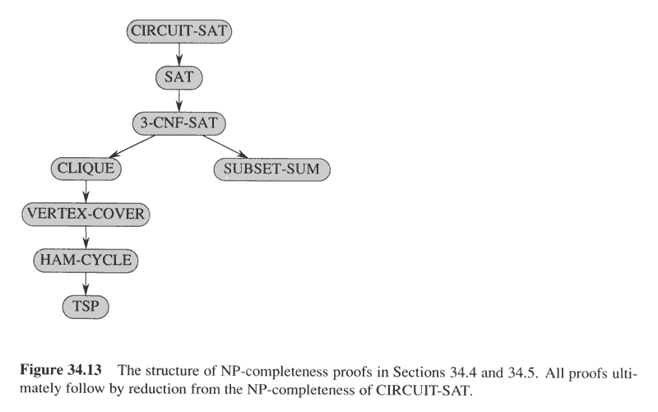
NP-completeness proof structure

Slide 48
NPC proof -- CLIQUE
Definition: a clique in an undirected graph G=(V,E) is a subset V'⊆V of vertices, each pair of which is connected by an edge in E, i.e., a clique is a complete subgraph of G.
Size of a clique is the number of vertices in the clique.
Optimization problem: find the maximum clique.
Decision problem: whether a clique of given size k exists in the graph?
CLIQUE={<G,k>: G is a graph with a clique of size k.}
Intuitive solution: ???

Slide 49
CLIQUE is NP-complete
Theorem 34.11: (page 1003)
CLIQUE problem is NP-complete.
Proof:
CLIUEQE ∈NP: given G=(V,E) and a set V'⊆V as a certificate for G. The verifying algorithm checks for each pair of u,v∈V', whether <u,v> ∈E. time: O(|V'|²|E|).
CLIQUE is NP-hard:
show 3-CNF-SAT ≤_{p}CLUQUE.
The result is surprising, since from boolean formula to graph.

Slide 50
CLIQUE is NP-complete
Reduction from 3-CNF-SAT to CLUQUE.
Suppose φ=C₁∧ C₂∧… ∧C_{k} be a boolean formula in 3-CNF with k clauses.
We construct a graph G=(V,E) as follows:
For each clause C_{r} =(l₁^{r}∨ l₂^{r}∨ l₃^{r}), place a triple of v₁^{r}, v₂^{r}, v₃^{r} into V
Put the edge between two vertices v_{i}^{r} and v_{j}^{s} when:
r≠s, that is v_{i}^{r} and v_{j}^{s} are in different triples, and
Their corresponding literals are consistent, i.e, l_{i}^{r} is not negation of l_{j}^{s} .
Then φ is satisfiable if and only if G has a clique of size k.

Slide 51
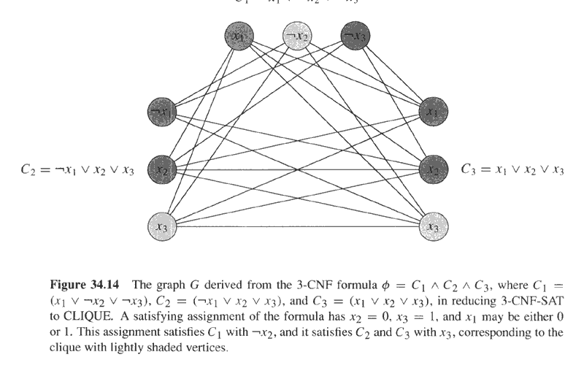
φ=(x₁∨¬x₂∨¬x₃)∧(¬x₁∨x₂∨x₃)∧(x₁∨x₂∨x₃) and its reduced graph G
C₁=x₁∨¬x₂ ∨¬x₃

Slide 52
CLIQUE is NP-complete
Prove the above reduction is correct:
If φ is satisfiable, then there exists a satisfying assignment, which makes at least one literal in each clause to evaluate to 1. Pick one this kind of literal in each clause. Then consider the subgraph V' consisting of the corresponding vertex of each such literal. For each pair v_{i}^{r},v_{j}^{s} ∈V', where r≠s. Since l_{i}^{r},l_{j}^{s} are both evaluated to 1, so l_{i}^{r} is not negation of l_{j}^{s}, thus there is an edge between v_{i}^{r} and v_{j}^{s}. So V' is a clique of size k.
If G has a clique V' of size k, then V' contains exact one vertex from each triple. Assign all the literals corresponding to the vertices in V' to 1, and other literals to 1 or 0, then each clause will be evaluated to 1. So φ is satisfiable.
It is easy to see the reduction is in poly time.
The reduction of an instance of one problem to a specific instance of the other problem.

Slide 53
Traveling-salesman problem is NPC
TSP={<G,c,k>:
G=(V,E) is a complete graph,
c is a function from V×V→Z,
k∈Z, and G has a traveling salesman
tour with cost at most k.}
Theorem 34.14: (page 1012)
TSP is NP-complete.

Slide 54
TSP is NP-complete
TSP belongs to NP:
Given a certificate of a sequence of vertices in the tour, the verifying algorithm checks whether each vertex appears once, sums up the cost and checks whether at most k. in poly time.
TSP is NP-hard (show HAM-CYCLE≤_{p}TSP)
Given an instance G=(V,E) of HAM-CYCLE, construct a TSP instance <G',c,0) as follows (in poly time):
G'=(V,E'), where E'={<i,j>: i,j∈ V and i≠j} and
Cost function c is defined as c(i,j)=0 if (i,j) ∈E, 1, otherwise.
If G has a hamiltonian cycle h, then h is also a tour in G' with cost at most 0.
If G' has a tour h' of cost at most 0, then each edge in h' is 0, so each edge belong to E, so h' is also a hilmitonian cycle in G.

Slide 55
Subset Sum is NPC
SUNSET-SUM={<S,t>: S is a set of integers and there exists a S'⊆S such that t=∑_{s∈S'}s.}
Theorem 34.15: (page 1014)
SUBSET-SUM is NP-complete.

Slide 56
SUBSET-SUM is NPC
SUBSET-SUM belongs to NP.
Given a certificate S', check whether t is sum of S' can be finished in poly time.
SUBSET-SUM is NP-hard (show 3-CNF-SAT≤_{p}SUBSET-SUM).

Slide 57
SUBSET-SUM is NPC
Given a 3-CNF formula φ=C₁∧ C₂∧… ∧C_{k} with literals x₁, x₂,…, x_{n}. Construct a SUBSET-SUM instance as follows:
Two assumptions: no clause contains both a literal and its negation, and either a literal or
its negation appears in at least one clause.
The numbers in S are based on 10 and have n+k digits, each digit corresponds to (or is labeled by) a literal or a clause.
Target t=1…1||4…4 (n 1’s and k 4’s)
For each literal x_{i}, create two integers:
v_{i}=0…01_{(i)}0…0||0…01_{(l)}0…01_{(w)}0…0, where x_{i} appears in C_{l},…,C_{w.}
v_{i}'=0…01_{(i)}0…0||0…1_{(m)}0……01_{(p)}0…0, where ¬x_{i} appears in C_{m},…,C_{p.} .
Clearly, v_{i} and v_{i}' can not be equal in right k digits, moreover all v_{i} and v_{i}' in S are distinct.
For each clause C_{j}, create two integers:
s_{j}=0…0||0…01_{(j)}0…0,
s_{j}'=0…0||0…02_{(j)}0…0.
all s_{j} and s_{j}' are called “slack number”. Clearly, all s_{j} and s_{j}' in S are distinct.
Note: the sum of digits in any one digit position is 2 or 6, so when there is no carries when adding any subset of the above integers.

Slide 58
SUBSET-SUM is NPC
The above reduction is done in poly time.
The 3-CNF formula φ is satisfiable if and only if there is a subset S' whose sum is t.
suppose φ has a satisfying assignment.
Then for i=1,…,n, if x_{i}=1 in the assignment, then v_{i} is put in S', otherwise, then v_{i}' is put in S'.
The digits labeled by literals will sum to 1.
Moreover, for each digit labeled by a clause C_{j} and in its three literals, there may be 1, 2, or 3 assignments to be 1. correspondingly, both s_{j} and s_{j}' or s_{j}', or s_{j} is added to S' to make the sum of the digit to 4.
So S' will sum to 1…14…4.
Suppose there is a S' which sums to 1…14…4. then S' contains exact one of v_{i} and v_{i}' for i=1,…,n. if v_{i}∈ S', then set x_{i}=1, otherwise, v_{i}'∈ S', then set x_{i}=0. It can be seen that this assignment makes each clause of φ to evaluate to 1. so φ is satisfiable.

Slide 59
Thank You !!!

